Slide 1
To see detailed explanation of the diagrams in this file, please refer to Word Document “Overview of CM’s project 12.06.18”

Slide 2
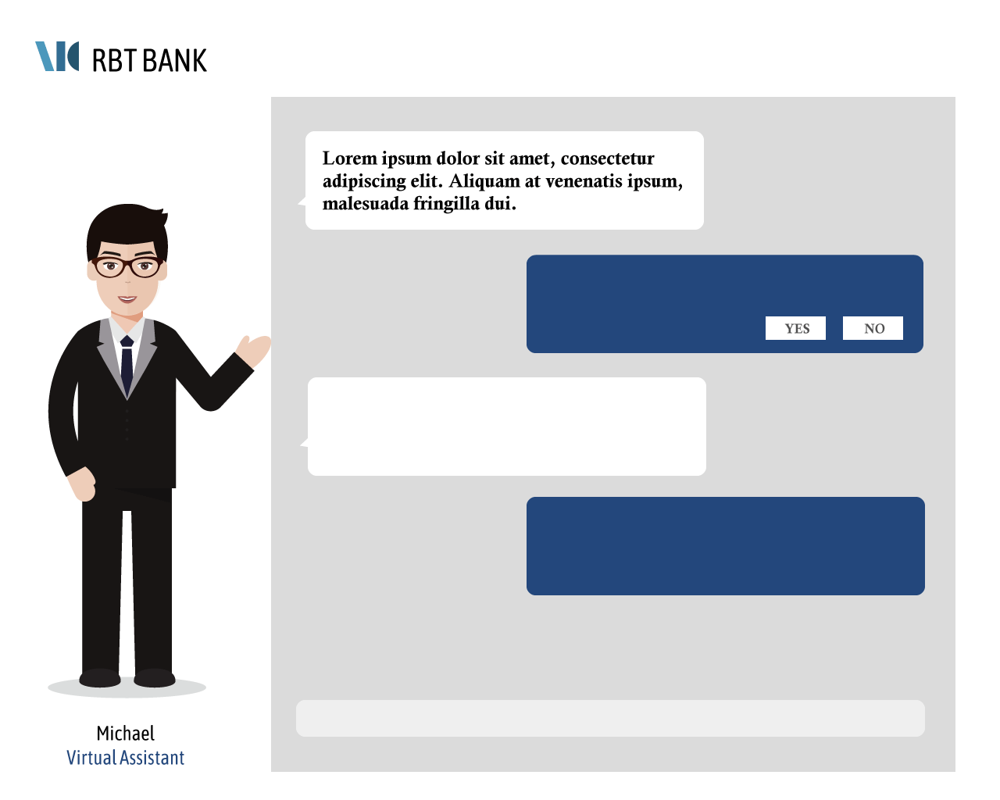
Mock-ups for Study 1
S
S
Mock-up of introduction page
Avatar appearance is variable: can be male or female
Study 1
Introduction
Meet your conversational virtual assistant, Zan/Michelle/Michael.
Zan/Michelle/Michael is a conversational personal finance assistant who can help you with basic tasks, for example setting up a bank account. Using the information that you provide, Zan/Michelle/Michael is able to compute the best recommendation just for you. Zan/Michelle/Michael is designed by the Customer Experience and Tech team at RBT bank, who have 8 combined years of customer experience and 9 combined years of computer programming experience.
Today, you will go through a demonstration session where Zan/Michelle/Michael will help you with three simple personal finance tasks:
1. Choosing a bank savings account
2. Choosing a home loan plan
3. Choosing a life insurance policy
[Click here to begin.]
KIV Set-up page (waiting to refer to Yihan’s)
Please enter your matric number: ________
Study 2
Take reference from Yihan’s
Intro text to be CONSISTENT with avatar appearance gender: either male or female
Avatar appearance to be CONSISTENT with that on intro page
Conversation script to be FIXED: only use NEUTRAL script
Mock-up of chatting page
Mock-up of survey page (after each task)
Mock-up of survey page (continued)
Evaluation of Experience
Evaluation of Experience
Repeat “chat & survey page sequence” 3x because there are 3 separate tasks in the script and a survey is done after each task
Refer to slide 5 for enlarged version
Refer to slide 6 for enlarged version

Slide 3
Mock-ups for Study 2
S
S
Mock-up of introduction page
Avatar appearance is variable: can be male or female
Study 1
Introduction
Meet your conversational virtual assistant, Zan/Michelle/Michael.
Zan/Michelle/Michael is a conversational personal finance assistant who can help you with basic tasks, for example setting up a bank account. Using the information that you provide, Zan/Michelle/Michael is able to compute the best recommendation just for you. Zan/Michelle/Michael is designed by the Customer Experience and Tech team at RBT bank, who have 8 combined years of customer experience and 9 combined years of computer programming experience.
Today, you will go through a demonstration session where Zan/Michelle/Michael will help you with three simple personal finance tasks:
1. Choosing a bank savings account
2. Choosing a home loan plan
3. Choosing a life insurance policy
[Click here to begin.]
KIV Set-up page (waiting to refer to Yihan’s)
Please enter your matric number: ________
Study 2
Take reference from Yihan’s
Intro text to be CONSISTENT with avatar appearance gender: either male or female
Avatar appearance to be CONSISTENT with that on intro page
Conversation script is a variable INDEPENDENT of avatar appearance: can be male or female
Mock-up of chatting page
Mock-up of survey page (after each task)
Mock-up of survey page (continued)
Evaluation of Experience
Evaluation of Experience
Repeat “chat & survey page sequence” 3x because there are 3 separate tasks in the script and a survey is done after each task
Refer to slide 5 for enlarged version
Refer to slide 6 for enlarged version

Slide 4
Mock-ups for Online Pilot Study
S
S
Mock-up of introduction page
Note that the online pilot Intro page WILL NOT DISPLAY the virtual assistant
Introduction
Meet your conversational virtual assistant, Zan/Michelle/Michael.
Zan/Michelle/Michael is a conversational personal finance assistant who can help you with basic tasks, for example setting up a bank account. Using the information that you provide, Zan/Michelle/Michael is able to compute the best recommendation just for you. Zan/Michelle/Michael is designed by the Customer Experience and Tech team at RBT bank, who have 8 combined years of customer experience and 9 combined years of computer programming experience.
Today, you will go through a demonstration session where Zan/Michelle/Michael will help you with three simple personal finance tasks:
1. Choosing a bank savings account
2. Choosing a home loan plan
3. Choosing a life insurance policy
[Click here to begin.]
Randomization of conditions (not shown to respondents)
Please enter your matric number: ________
KIV Set-up (waiting to refer to Yihan’s)
KIV Set-up (waiting to refer to Yihan’s)
Intro text to be FIXED: Only use NEUTRAL version
Note that the chat page WILL NOT DISPLAY the virtual assistant
Conversation script is a variable: can be NEUTRAL, MALE OR FEMALE
Mock-up of chatting page
Mock-up of survey page (after each task)
Mock-up of survey page (continued)
Evaluation of Experience
Evaluation of Experience
Repeat “chat & survey page sequence” 3x because there are 3 separate tasks in the script and a survey is done after each task
Refer to slide 5 for enlarged version
Refer to slide 6 for enlarged version

Slide 5
Enlarged version: Mock-up of survey page (after each task)
Refer to “Script” document for Word Doc file of the question
Evaluation of Experience

Slide 6
Enlarged version: Mock-up of survey page (continued)
Refer to “Script” document for Word Doc file of the question
Evaluation of Experience

